Slide 1
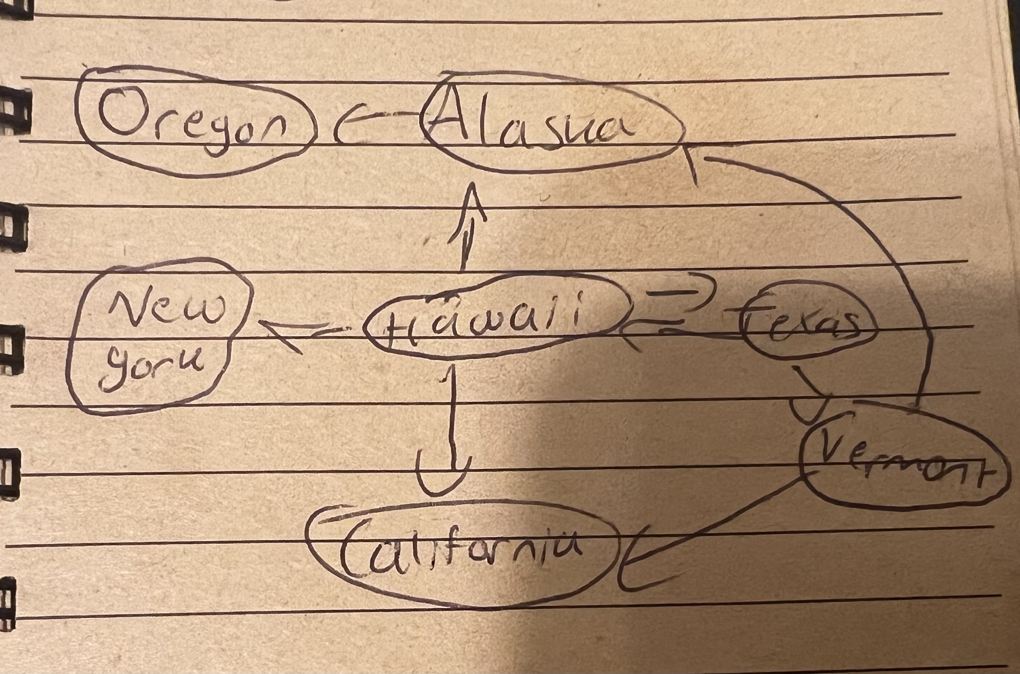
CMSC204
Kartchner
V(StateGraph) = {Oregon, Alaska, Texas, Hawaii, Vermont, NewYork, California}
E(StateGraph) = {(Alaska, Oregon), (Hawaii, Alaska), (Hawaii, Texas), (Texas, Hawaii), (Hawaii, California), (Hawaii, New York), (Texas, Vermont), (Vermont, California), (Vermont, Alaska)}
1. Draw the StateGraph

Slide 2
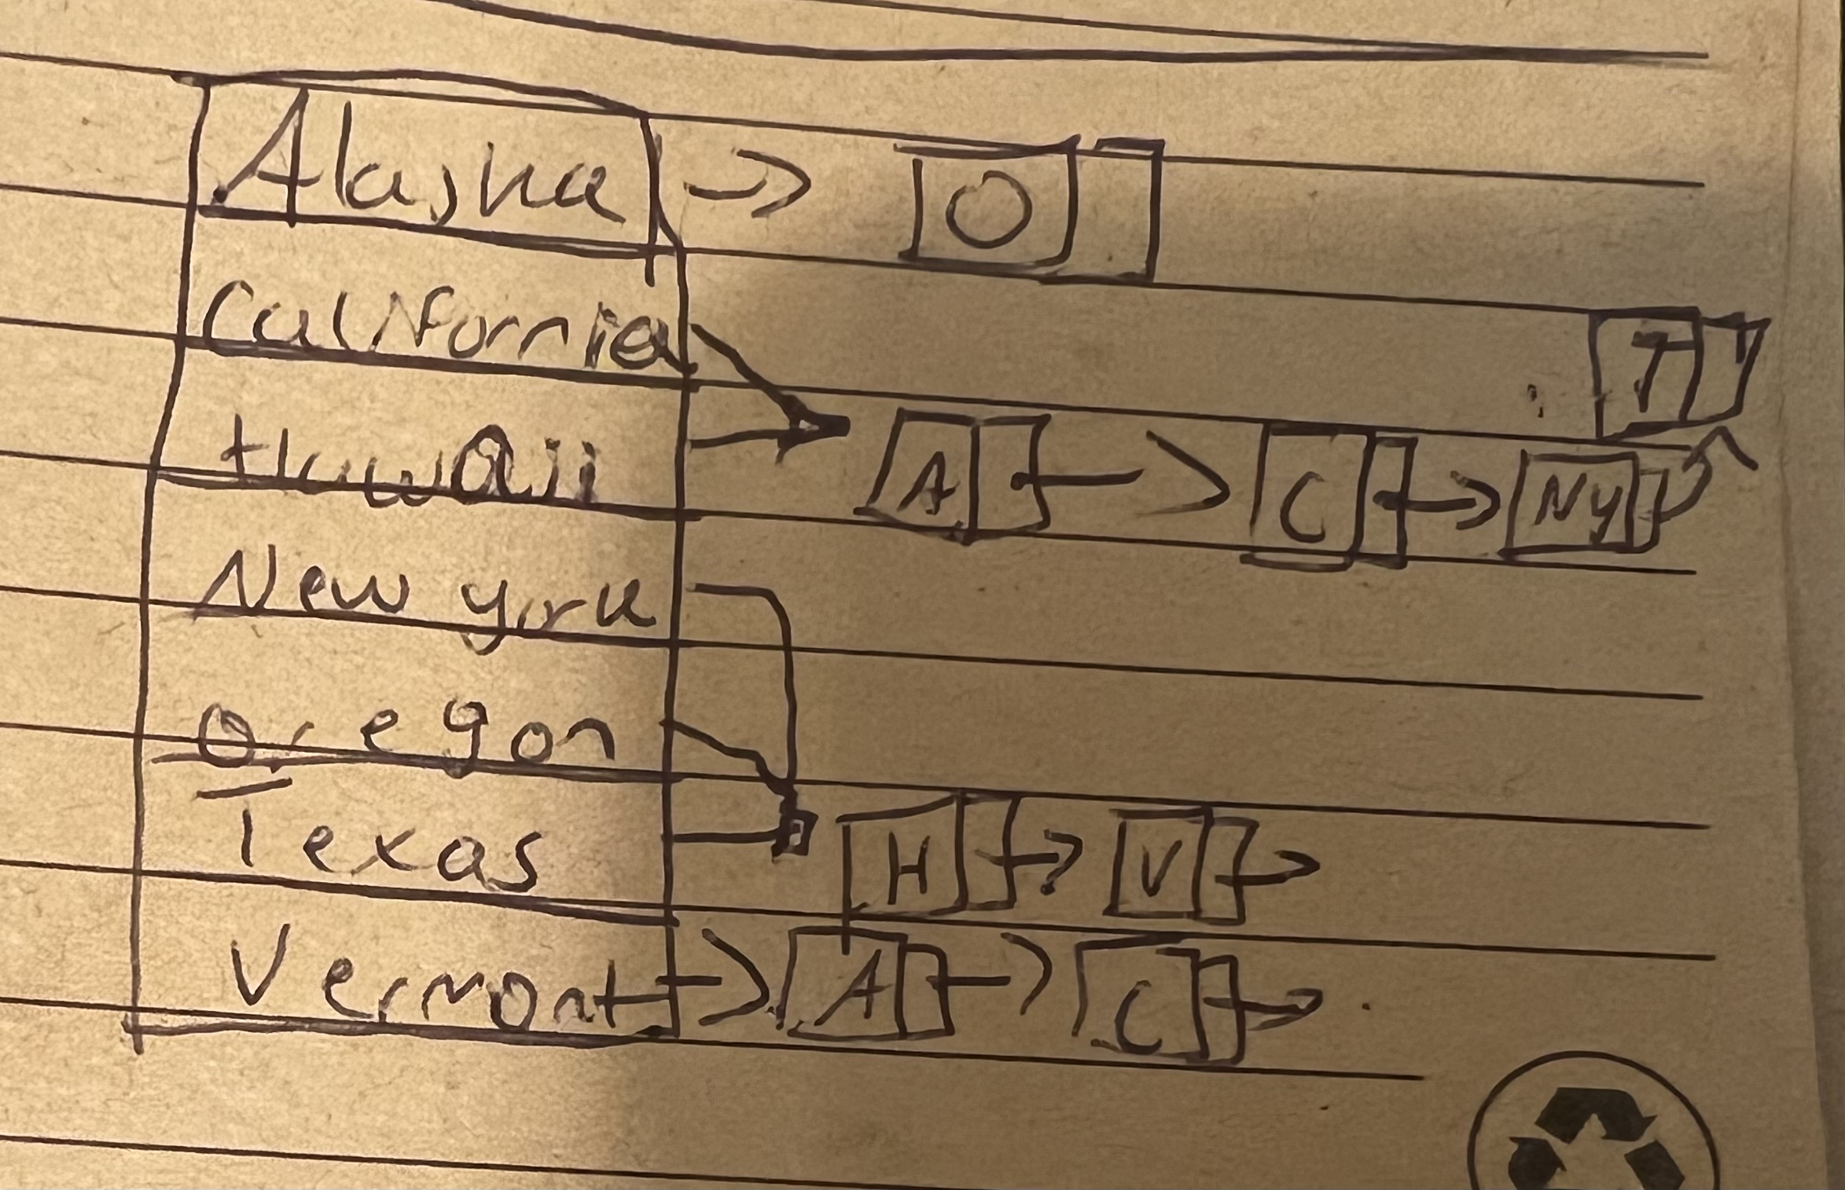
a. Show the adjacency matrix that would describe the edges in the graph. Store the vertices in alphabetical order
States
0 | Alaska
1 | California
2 | Hawaii
3 | New York
4 | Oregon
5 | Texas
6 | Vermont
 | 0 | 1 | 2 | 3 | 4 | 5 | 6
 | 0 | 0 | 0 | 0 | 1 | 0 | 0
1 | 0 | 0 | 0 | 0 | 0 | 0 | 0
2 | 1 | 1 | 0 | 1 | 0 | 1 | 0
3 | 0 | 0 | 0 | 0 | 0 | 0 | 0
4 | 0 | 0 | 0 | 0 | 0 | 0 | 0
5 | 0 | 0 | 1 | 0 | 0 | 0 | 1
6 | 1 | 1 | 0 | 0 | 0 | 0 | 0
3. b. Show the adjacency lists
that would describe the edges in the graph

Slide 3
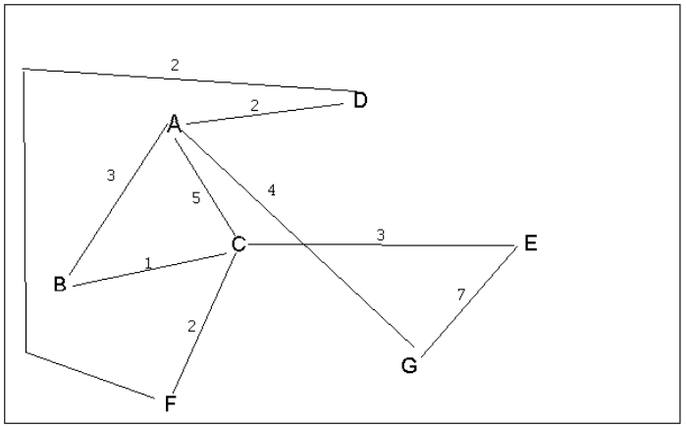
4 a. Which of the following lists the graph nodes in depth first order beginning with E?
A) E, G, F, C, D, B, A
B) G, A, E, C, B, F, D
C) E, G, A, D, F, C, B (C)
D) E, C, F, B, A, D, G
4 b. Which of the following lists the graph nodes in breadth first order beginning at F?
A) F, C, D, A, B, E, G (A)
B) F, D, C, A, B, C, G
C) F, C, D, B, G, A, E
D) a, b, and c are all breadth first traversals

Slide 4
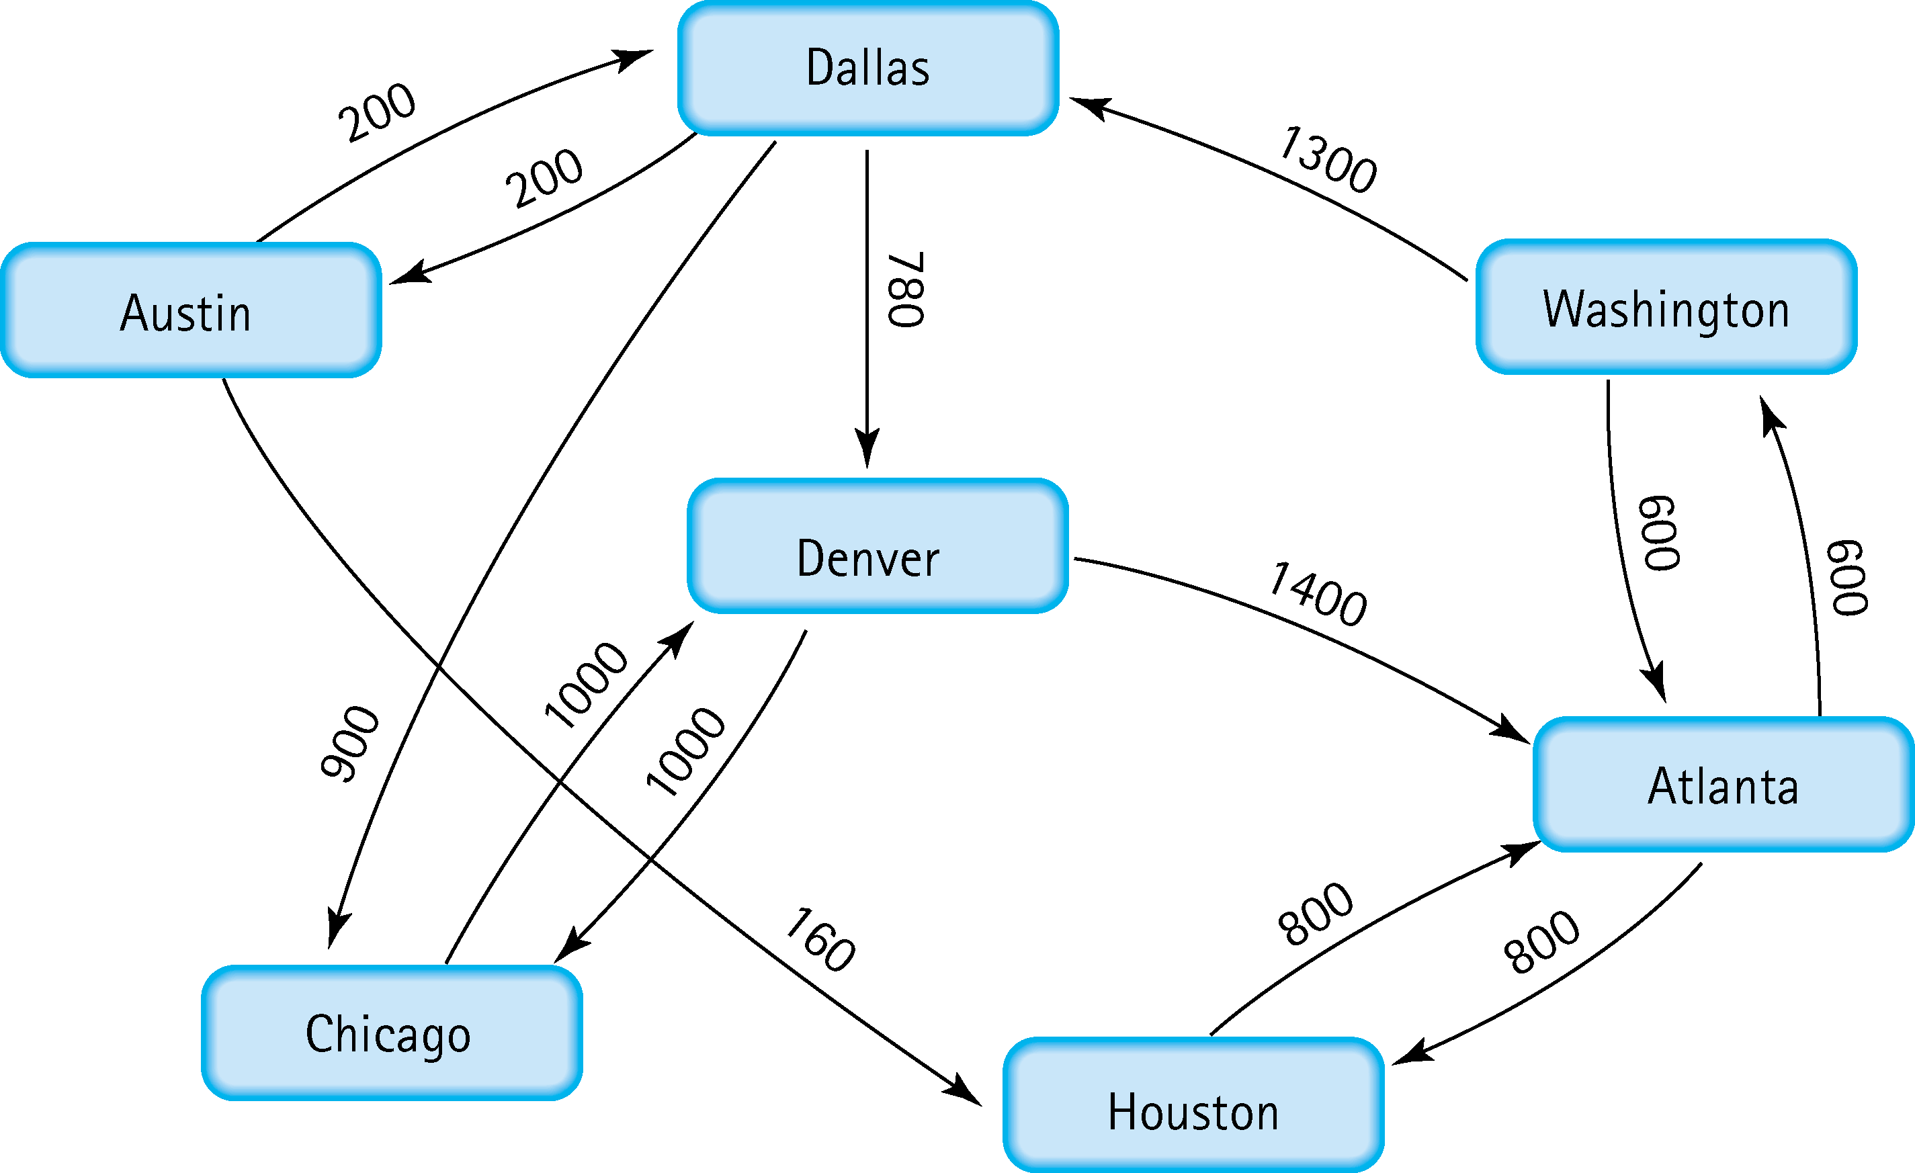
Find the shortest distance from Atlanta to every other city
Atalanta to Washington, Atlanta to Houston, Atlanta to Denver, Atlanta to Dallas, Atlanta to Chicago,
Atlanta to Austin

Slide 5
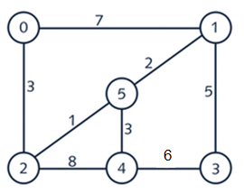
6. Find the minimal spanning tree using Prim’s algorithm. Use
0 as the source vertex . Show the steps.
Add 0 to the minimal spanning tree.
See the edges beside it and choose 3 considering it is the smaller weight
Add 2 and then take the edge of length 1
Pick 5 then take the edge of 1 picking up vertices 1
Then choose between edges 5 and 7 so choose 5 the smaller one
Pick up 3 and consider the between 3 and 6 edges so pick up 4

Slide 6
7. Find the minimal spanning tree using Kruskal’s algorithm.
Show the weights in order and the steps.
2-5(1)
1-5(2)
0-2(3)
4-t(3)
1-3(5)

Slide 7
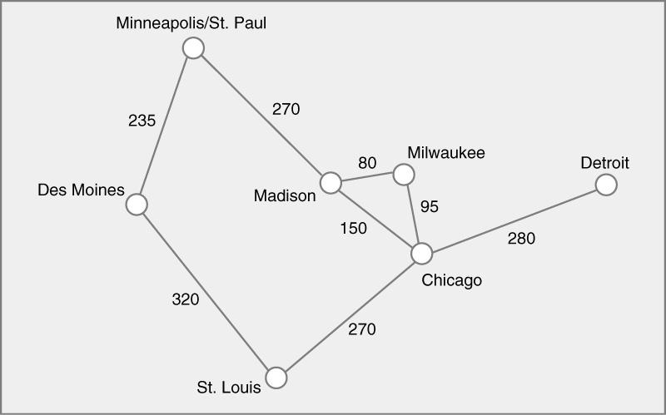
8. Find the minimal spanning tree using the algorithm you prefer. Use
Minneapolis/St. Paul as the source vertex
Minneapolis to Des Moines to St. Louis to Chicago to Milwaukee to
Madison, to Detroit

Slide 8
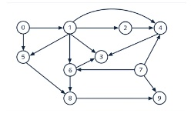
9. List the nodes of the graph in a breadth first topological ordering. Show the
steps using arrays predCount, topologicalOrder and a queue
0 | 1 | 2 | 3 | 4 | 5 | 6 | 7 | 8 | 9
PredCount | 0 | 0 | 0 | 0 | 0 | 0 | 0 | 0 | 0
Topological order | 0 | 7 | 1 | 2 | 5 | 6 | 3 | 8 | 3
Queue | 0 | 7 | 1 | 2 | 5 | 6 | 4 | 8 | 3

Slide 9

10. List the nodes of the graph in a breadth first topological ordering.
Topological order: Start, Discrete math, programming 1, programming 2, computer
Organization, Algorithms, High-level language, operating systems, Theory of
Computation, compilers, senior seminar, end.

